Slide 1
Text Auto-Correction
Using Edit Distance and N-Gram Models
By Endla Rahul-24ETCS126007

Slide 2
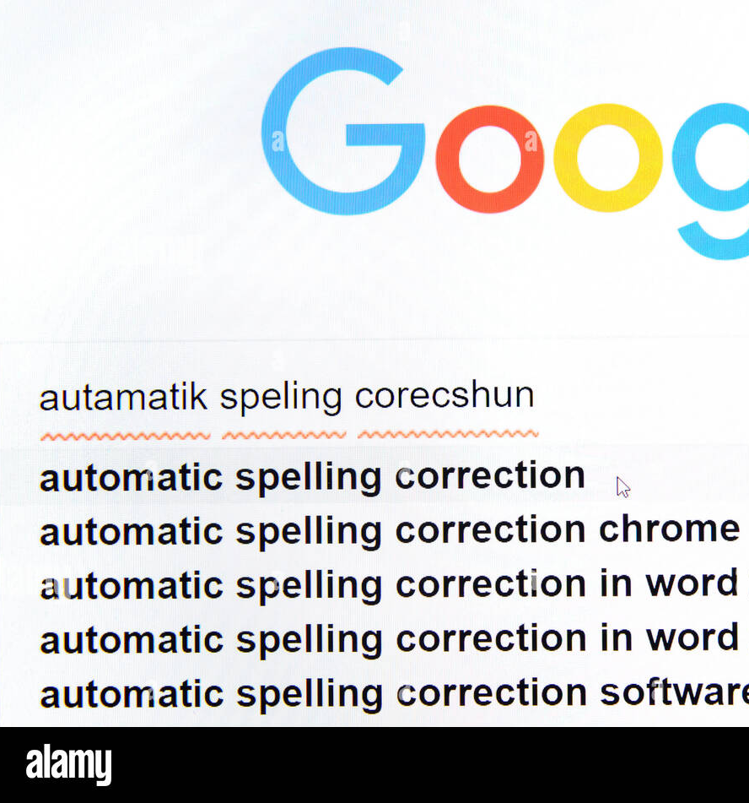
Introduction
Corrects spelling and grammar in text.
Combines statistical methods with deep learning.
Applications: Messaging apps, Search engines, Assistive tech.

Slide 3
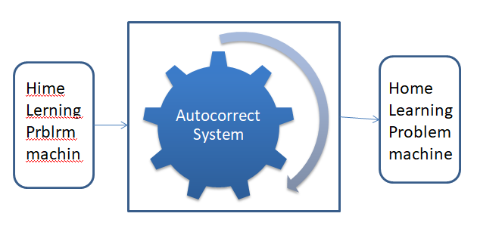
Why Auto-Correction?
Human errors are common in writing.
Manual correction is time-consuming.
Context matters in correction.

Slide 4
Core Objective
Detect incorrect words
Suggest correct alternatives
Maintain sentence meaning

Slide 5
DATA FOUNDATION
Corpus Used: Brown, Reuters, English Words List
Provides vocabulary and language model foundation.

Slide 6
N-GRAM Models & Frequency
N-grams form the basis of n-gram models, which are statistical language models that predict the probability of a word given the preceding (n-1) words.
Unigrams (single-word frequencies)
Bigrams (two-word sequences)
Used to evaluate correction likelihood.

Slide 7
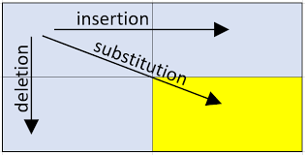
Edit Distance
Levenshtein Distance: Minimum operations to convert words.
Operations: Insert, Delete, Replace.
Used for finding spelling corrections.

Slide 8
Correction Engine
Checks each word in a sentence.
If misspelled, generates candidate corrections.
Selects best correction based on sentence probability.

Slide 9
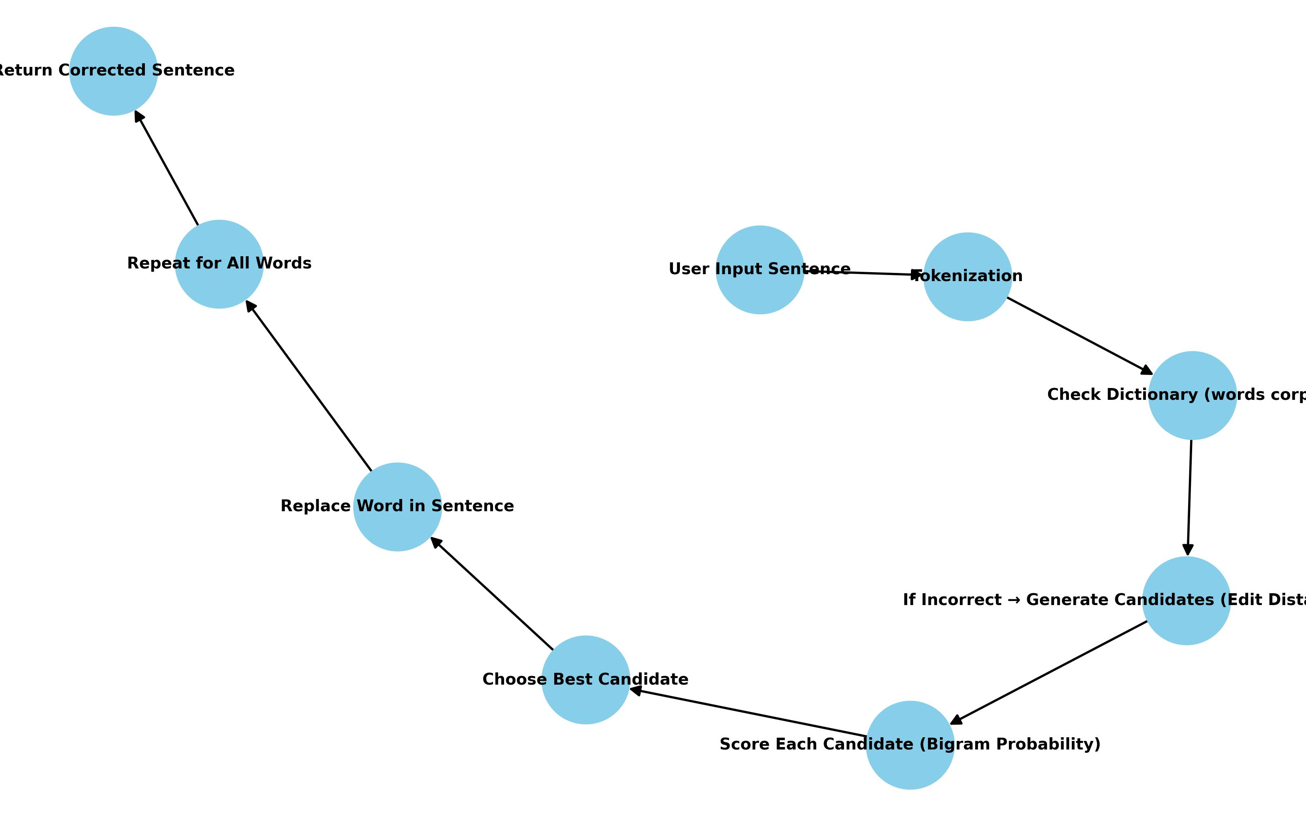
BLOCK DIAGRAM

Slide 10
Sample Output
Input: whre are you, I have ben wating since lote tme.
Corrected : where are you, I have been waiting since long time.

Slide 11
Limitations & Future Work
Edit Distance is slow on large vocab.
Bigram models lack deep context.
Future: Combine statistical + neural, use beam search, optimize runtime.

Slide 12
Conclusion
Hybrid correction approach: Rule-based + Transformer.
Effective on spelling, grammar, and fluency.
Can be extended into production-grade correction engines.

Slide 13

.

